Slide 1
Objectives
In this session, you will:
  Identify the communication traits while participating in a meeting
  Conduct a meeting effectively
  Define the Minutes of a Meeting (MOM)
  State the purpose of writing the MOM
  List the components of the MOM
  Understand the guidelines for writing the MOM
  State the guidelines for interacting with a client

Slide 2
Participating in a Meeting
A meeting is a common platform where people interact for a cause.
Business meetings are gatherings where strategies and policies are articulated, discussed, and debated and deals are finalized or fall apart.
The communication traits that you need to focus on while participating in a meeting are:
  Assertiveness
  Clarity
  Language
  Body language
  Relevance
  Pacing and rate of speech

Slide 3
Conducting a Meeting Effectively
In meetings, you can:
  Communicate your ideas.
  Share your feelings.
  Engage with others.
  Develop new understandings.
  Explore new directions.
Organizing a meeting effectively involves the following phases:
  Prepare for the meeting
  During the meeting
  After the meeting

Slide 4

Preparing for the Meeting
While preparing for a meeting, the following considerations should be kept in mind:
  Consider the relevance of the meeting.
  Establish meeting objectives.
  Create an agenda.
  Inform the participants.
  Make necessary arrangements.

Slide 5

During the Meeting
The following rules should be adhered to during meetings:
  Be punctual.
  Initiate small talk.
  Greet the members.
  Review the agenda.
  Participate actively.
  Be careful while interrupting others.
  Take notes.
  Wrap-up the meeting.

Slide 6

After the Meeting
The following steps should be performed to complete the meeting process:
  Prepare the MOM.
  Take appropriate measures.

Slide 7
Activity: Conducting a Meeting Effectively
In this activity, you will learn to conduct a meeting effectively.

Slide 8
Importance of MOM
The MOM helps you to:
  Record important discussions.
  Provide a record of the meeting.
  Update the participants who could not attend.
  Provide a written documentation.
  Serve as a reminder.

Slide 9
Contents of an MOM
The contents of an MOM include:
  The date, time, and venue of the meeting.
  The names of all those who attended and those from whom ‘apologies of absence’ were received.
  The main topics of discussion.
  A brief summary of each discussion.
  The conclusion of each topic of discussion.
  The action to be taken.
  The people responsible for the actions to be taken.

Slide 10
Guidelines for Writing an MOM
The guidelines for writing an MOM are:
  Check if the organization uses a particular format for writing the minutes.
  Use subpoints, if required.
  Do not get caught up in the discussion that you forget to take notes.
  Draft the minutes immediately after the meeting.
  Proofread the minutes carefully.

Slide 11
Activity: Preparing the MOM
In this activity, you will learn to write an effective MOM.

Slide 12
Guidelines for Interacting With a Client
The guidelines for interacting with a client are:
  Be careful while giving gifts.
  Identify the degree of formality.
  Take care of body language.
  Use appropriate language.
  Avoid sensitive subjects.
  Appreciate cultural differences.

Slide 13
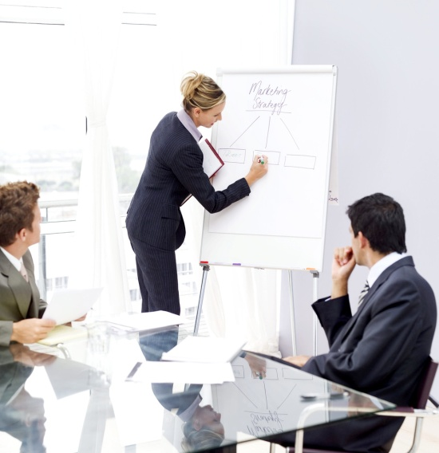
Activity: Interacting With a Client
In this activity, you will learn to interact with a client in a meeting.

Slide 14
Summary
In this session, you learned that:
  The guidelines for participating in a meeting are:
    Assertiveness
    Clarity
    Language
    Body language
    Pacing and rate of speech
  Organizing a meeting effectively involves the following phases:
    Preparing for the meeting
    During the meeting
    After the meeting
Notes:
Use this and the following slides to summarize the key concepts of the session to the students.

Slide 15
Summary (Contd.)
  While preparing for the meeting, the following considerations should be kept in mind:
    Consider the relevance of the meeting.
    Establish meeting objectives.
    Prepare a meeting agenda.
    Inform the participants.
    Make necessary arrangements.
  The following steps should be performed to complete the meeting process:
    Prepare the MOM.
    Take appropriate measures.

Slide 16
Summary (Contd.)
  The MOM helps you to:
    Record important discussions.
    Provide a record of the meeting.
    Update the participants who could not attend.
    Provide a written documentation.
    Serve as a reminder.
  The guidelines for interacting with a client are:
    Be careful while giving gifts.
    Identify the degree of formality.
    Take care of body language.
    Use appropriate language.
    Avoid sensitive subjects.
    Appreciate cultural differences.

